Slide 1
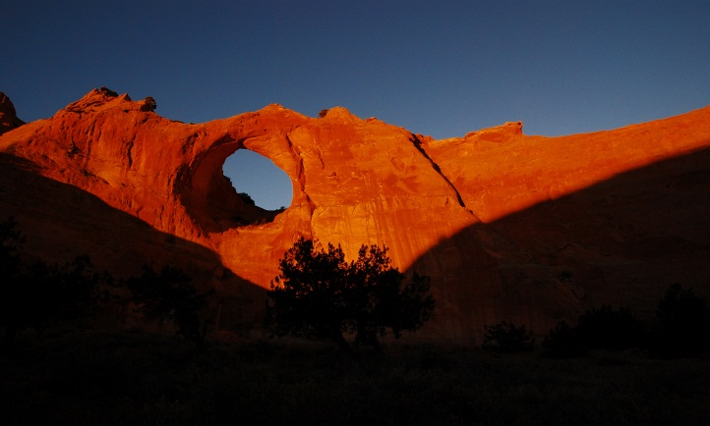
The Navajo Nation
“The Movement from a Division of Health to a Navajo Nation Department of Health and Plans to obtain PHAB Accreditation”
Presentation by
Anita Muneta, MPH, Performance Improvement Manager
anita.muneta@nndoh.org (928) 871-6124
National Indian Health Board mid year l Consumer Conference
Tulsa, Oklahoma
May 31, 2012

Slide 2

Learning Objectives
Participants will be aware of :
the Navajo Nation’s plans to become a Navajo Nation Department of Health structured similarly to a state department of public health and
its efforts to seek PHAB accreditation

Slide 3
The Navajo Nation
The largest federally recognized land based Indian tribe in the United States.
The total estimated Navajo population is over 300,000.
It extends into three States (AZ, NM, Utah) and thus three U.S. Department of Health and Human Services’ Regions including Region VI, Region VIII and Region IX.
Land base of nearly 27,000 square miles.
Organized into 110 local governments referred to as Chapters.

Slide 4
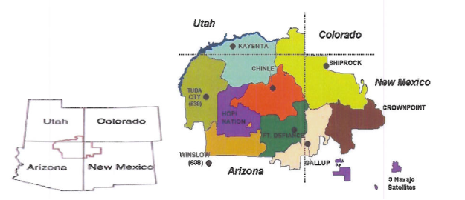
The Navajo Nation

Slide 5
The Navajo People
Also known as Diné.
Values include family or K’é , the Navajo clan system of a matrilineal society, respect, the Navajo language, education, history, laughter, livestock, natural resources and health.
The fundamental lifeway path is Hózhó , “Balance in one’s health, mental health, spirit, thinking, planning, living, etc..”

Slide 6
The Navajo Nation Socioeconomic Characteristics
The Navajo Nation has a higher percentage of children and a lower percentage of elders than the U.S., although the elder population is currently growing more rapidly than other age groups.
The Per capita income for Navajo is 1/3 that of the U.S.; Unemployment is twice the U.S. rate; and 45.3% of Navajo children and 40% of Navajo families live below the poverty level.

Slide 7
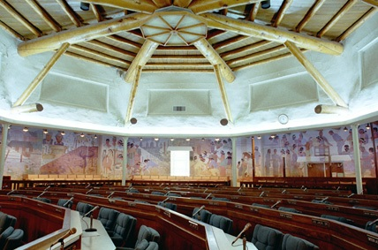
The Navajo Nation Government
Is a Three Branch government centrally headquartered in Window Rock, Arizona.
The Executive Branch is operated by an elected President and Vice President.
The Legislative Branch is administered by the Speaker of the Navajo Nation Council, consisting of 24-elected council delegates
The Judicial Branch is administered by the Chief Justice of the Navajo Nation.

Slide 8
Navajo Health Systems
STATES
Private providers
Traditional
IHS
NDOH
‘638

Slide 9
NDOH Background
The Division of Health Improvement Services was established in 1977.
In 1995, an enabling legislation approved by the NNC, amended DHIS to the Navajo Division of Health (NDOH).
NDOH is to plan, develop, promote, maintain, preserve, & regulate the overall health, wellness and fitness programs for the Navajo people.
NDOH provides health services to Navajo individuals and families.
The mission of the NDOH: Diné bi ts’iis, bini’ doo bee iina’ ba’aahaya (Taking care of Navajo People—body, mind and life).
The goal of NDOH is to increase the years of healthy, functional, and productive lives of the Navajo citizens and communities consistent with the Navajo cultural values.
Notes:
Navajo Division of Health and the NAIHS have been meeting with 3 States (AZ, NM and UT) to ease the burden on Medicaid beneficiaries, because the Navajo Nation:
Extends into 3 States (AZ, NM and UT);
Extends into 3 Federal Regions (6, 8 and 9);
There are about 84,950 Medicaid beneficiaries (49,803 in AZ; 31,504 in NM; 2,643 in UT); and
Population include approximately 17,500 individuals are 60+ years old; of which about 90% do not have birth certificates because they were not born in hospital.
In October 2007, a Navajo Nation delegation met with the Acting CMS Administrator Mr. Kerry Weems in Albuquerque, NM to reiterate concerns with the Section 6036 requirements. Mr. Weems assured Navajo that he would look into the issues.
Subsequently, the TTAG, which is an advisory committee to the CMS to provide input on CMS programs and policies that impact American Indians/Alaska Natives, established a Subcommittee on Citizenship Documentation, in November 2007.
The Subcommittee is engaging in on-going discussions with CMS in an effort to get the citizenship documentation requirement address administratively.

Slide 10
NDOH Funding and Personnel
NDOH’s operating budget is $90 million with 1,200
staff Navajo Nation wide
Funding sources include
Federal (81%)
Navajo Nation General Funds ( 13%)
States of AZ and NM (6%)

Slide 11
NDOH administers key programs in the following areas:
Behavioral Health
Community Health Representatives
Health Education
Public Health Nursing services in the Kayenta Service area
Food and Sanitation codes enforcement
Aging (Senior citizen centers)
Diabetes prevention, outreach, and education
Uranium Mill compensation
Women Infants and Children (WIC)
Commodity Food Distribution
Breast and Cervical Cancer outreach and preventative education program
Public Health Emergency Preparedness
Steering committee planning activities for proposed new facilities in Dilkon,Az; Kayenta,AZ ; Gallup,NM and Pueblo Pintado, NM
New Dawn (a Horticulture program)
Epidemiology Center

Slide 12
Navajo Wellness Model
EAST
Blanca Peak
Sisnaajinii
Thinking & Honoring
NORTH
Dibe Ntsaa
Mount Hesperus
Reflecting & Protecting
SOUTH
Tsoodzil
Mount Taylor
Planning & Respecting
WEST
Dook o ooshliid
San Francisco Peak
Implementing & Caring

Slide 13
Navajo Public Health Functions
East
Monitor Health
Diagnose & Investigate
Research
South
Develop policies
Assure competent workforce
West
Link to health care
Inform, educate, empower
North
Enforce laws
Evaluate and make improvements
Notes:
The NN leaders recognizes the public health needs of their population continues to increase. As public health professionals we have a working understand between the difference of PUBLIC HEALTH and Medical/Clinical health and Traditional Health. One lesson learned during last weeks public hearing series is to not take for granted the general Indian population’s knowledge between PH and M/CH. Historically and today many AI/AN people practice local indegious wellness and healings through songs/chants/prayers/dance traditional medicine and cultural beliefs. The I.H.S. was established in 1955; implementing the western medical medical for “curing.” The Western Medical Model has made an impact among the Navajo people because we learned that although we provide PH through our NDOH programs; the general public seems confused about our presentation on the differences between PH and WMCM. The CDC defines PH:

Slide 14
The Navajo Health Status
Navajo mortality rates from all causes was higher than that of the U.S. in general. Life expectancy for Navajos was lower and years of productive life lost was much higher than the U.S.
Unintentional injuries are the leading cause of death for Navajo and is four times higher than the rate for the US; Within this category, Motor vehicle-related deaths are the leading causes of death and are five times higher than the rate for the US.
Heart disease, cancer, diabetes, and pneumonia/influenza are the 2nd, 3rd, 4th, and 5th leading causes of death for Navajos, respectfully.
post-neonatal mortality remains above the U.S. all-races rate; and teen pregnancy rates are higher than the U.S. rate.

Slide 15
The Navajo Health Status
Communicable Disease: Chlamydia rates are 2-3 times that of the U.S.; Navajo has experienced an increase in syphilis and HIV infections in the past 2-3 years; and while Tuberculosis infections and mortality has decreased, the rates remain higher than the U.S.
Environmental Health: Hantavirus and Plague are endemic/ major health concerns in the Navajo Nation
Only 78% of homes have running water and adequate sewage disposal; only 66% of homes have plumbing

Slide 16
The Navajo Health Status
Social and Mental Health:
Age-adjusted suicide mortality rate was 6% higher than that of the US population 11% ; Suicide attempts among the middle and high school students were more prevalent
The Alcoholism mortality rate is more than seven times higher than the U.S. population.

Slide 17
PLANNING TO BECOME
A DEPARTMENT OF HEALTH
and thus seek/obtain
PHAB
ACCREDITATION

Slide 18
Differences
Prevention focus
Regulatory component
Responsible for health and well-being of its citizens
Uniform/unified application in health arena (credibility)
Evidence-based health services
Essential PH functions
Education
Improved foundation for government-to-government relationships
Currently does not have the structure to support all DoPH functions
Limited authority –does not include all responsibilities of a nationwide public health authority (of all 10 essential public heath functions.)
No regulatory authority over health providers on the NN
Limited authority to protect the health/safety of the Nation
Department
Division

Slide 19
Differences
Puts research into practice
Establishes guidance & directions for health policies
Enforces codes
Training & technical assistance provider
Governmental responsibility for protection, health & safety for all age groups/citizens
Current health functions are smaller can expand under a NDoPH
Comprehensive policy development is a Deficiency; can establish policies itself vs. reacting to external policies handed down to develop health policy
Needs legislative authority for responsibility to be held accountable.
Limited regulatory function
Department
Division

Slide 20
Differences
Public health model differs from traditional health model
Screening, monitoring, managing
Correct health disparities
Prevention umbrella
Central repository for health data
Maintains status quo in professional qualifications; It needs to raise the qualifications and professional standards
Programs work in silos; it can be more coordinated and have less duplication
Department
Division

Slide 21
PHAB Beta Site Deficiencies
The NDOH volunteered to be a BETA Test Site to have a review of the organization conducted in preparation to become accredited as a NDoPH. A site visit and review of NDOH was conducted in August 11-12, 2010. Cited deficiencies were noted in the following areas:
Workforce
Data
Quality Improvement
Policies
To address these deficiencies, NNDOH will set up internal teams to address each of these areas for compliance with the standards.

Slide 22
Strategic Planning
A two day strategic planning session was held in August , 2011 and then again in January, 2012 with members of the NDOH executive team, program managers, key staff and stakeholders.
Consultants, facilitated the retreat through various exercises to prioritize the goals for the session, and develop a work product to comprise the substance of s strategic plan.
The Plan includes a series of Strategic Actions Steps to strengthen the organizational foundation of the division, helping to become a state-like department of public health.

Slide 23
Strategic Action Steps
Designed to provide a realistic “road map” to be followed by NDOH in positioning itself to become a NDoH.
Taken into account NDOH’s current environment & capabilities in outlining a series of actions required to address two major critical strategic priorities.

Slide 24
Two Major Critical Strategic Priority Issues
Strengthening Administrative Capacity and Infrastructure:
Critical infrastructure components must be in place to drive departmental operations, processes and systems to operate effectively and efficiently
Human Resources
Financial Management
IT/Data management

Slide 25
Two Major Critical Strategic Priority Issues
Program Planning, Policy and Operations:
Program development
Services delivery coordination
Services integration
Quality improvement
Alignment of programs and policy for administrative and program operations

Slide 26
T FIVE YEAR INFRASTRUCTURE IMPROVEMENT PLANS
These are currently still in draft form and include the following areas:

Slide 27
ORGANIZATION & PLANNING
Addresses the overall organizational structure for the transition
Creates a transition task force
Identifies key areas ( HR, Finance, IT, Data, etc.) requiring an assessment, and the development and implementation of transition plans in each of these identified areas
Calls for public hearings on the concept and transition efforts

Slide 28
LEGISLATION & POLICY
Addresses the passage of enabling legislation for a NNDOH
Addresses the development of key policies, rules, regulations, and needed enforcement codes for an effective NNDOH entity.

Slide 29
ADMINISTRATION & MANAGEMENT HUMAN RESOURCES
Addresses the development of a Human Resources Transition Plan
Addresses recruitment and retention issues including the development of a health careers initiative

Slide 30
FINANCE
Develop a Chief Finance Officer position
Develop a DOH Business Office
Develop and implement plans to increase revenues to NNDOH

Slide 31
IT/MIS
Conduct an assessment of needs in this area
Develop and implement a Division wide MIS Plan
Provide Division wide training in IT areas to Division staff

Slide 32
QUALITY CONTROL/ IMPROVEMENT
Develop a Division wide Quality Control/Improvement Office/Program including an office to regulate the licensure and certification of health care agencies and providers within the jurisdiction of the NN
Seek/obtain Public Health Accreditation (PHAB) status for the NNDOH
Create/establish an internal NNDOH performance management system

Slide 33
SERVICES
Conduct a comprehensive community wide health assessment to identify needs and service gaps
Develop/implement policies and procedures for program coordination to reduce duplication of services and/or for referrals
Implement Emerging, Best, and promising practices in the delivery of NNDOH services

Slide 34
DATA
Establish and operate a NN wide DATA Information and surveillance System/ center
Establish and operate a NN Health Research Center

Slide 35
Perceived Internal Challenges, Problems and Obstacles:
A huge “paradigm shift” needs to occur for all involved: existing staff, tribal legislators and leaders, the community etc.
Leadership and management –external perceptions of and credibility issues
Workforce issues:
hard to fill medical health professionals (physicians, nurses) are needed;
for existing staff, there is a fear of change, job insecurities, lack understanding of the proposed change.
Therefore, there is a lack of “buy in” and support from staff at all levels for the change.
For some staff, the position they hold may change to require them to obtain specific credentials in order to continue in the current position.

Slide 36
Perceived Internal Challenges, Problems and Obstacles:
An enabling legislation to make the staff to a NDoH as been in the wings awaiting presentation and approval for many years.
Lack of policies, procedures, and plans in place to effectively make the change/transition.
The current tribal support systems are programmatic and bureaucratic posing barriers to successfully implement needed changes.
NN divisions that traditionally do not work together will need to start coordinating, communicating and sharing responsibilities.

Slide 37
Perceived External Challenges, Problems and Obstacles:
Full funding in general from all potential sources
Cumbersome rules and regulations associated with funding sources.
Lack of facilities to house proposed tribal health programs in the regions, particularly in one primary facility.
Perceived lack of credibility of NDOH leadership and management with external partners (I.H.S. states, ‘638 Association, etc.).
Politics.

Slide 38
Perceived External Challenges, Problems and Obstacles:
Lack of understanding of the concept of public health vs. medical/clinical model.
Difference in interpretations of PL-93-638 between I.H.S. and NN.
Attracting needed professional staff to work for the NN.
States lack the recognition of NN’s role in health service delivery.
NN is not recognized as a sovereign nation by other government entities treating the NN primarily as a “contractor” of services and funds.
Fear of change and loss of control by external partners.

Slide 39
Additional NDOH Accomplishments
Received a five year CDC Grant to Strengthening Public Health infrastructure development. This grant is currently in its second year
Gained support from State Health Directors from Arizona, New Mexico and Utah, the Navajo Area Indian Health Service, and 638 Health Contractors in the Navajo Nation
Developed draft enabling legislation for the Navajo Department of Public Health.
Conducted Public Hearings on the transition in September , 2011

Slide 40

Why Would Our Health Department Want to be Accredited?
Benefits (individually and collectively)
Increased credibility, visibility and accountability
Potential access to new funds
Potential streamlined reporting
Access to knowledgeable peers for review and comment on performance

Slide 41
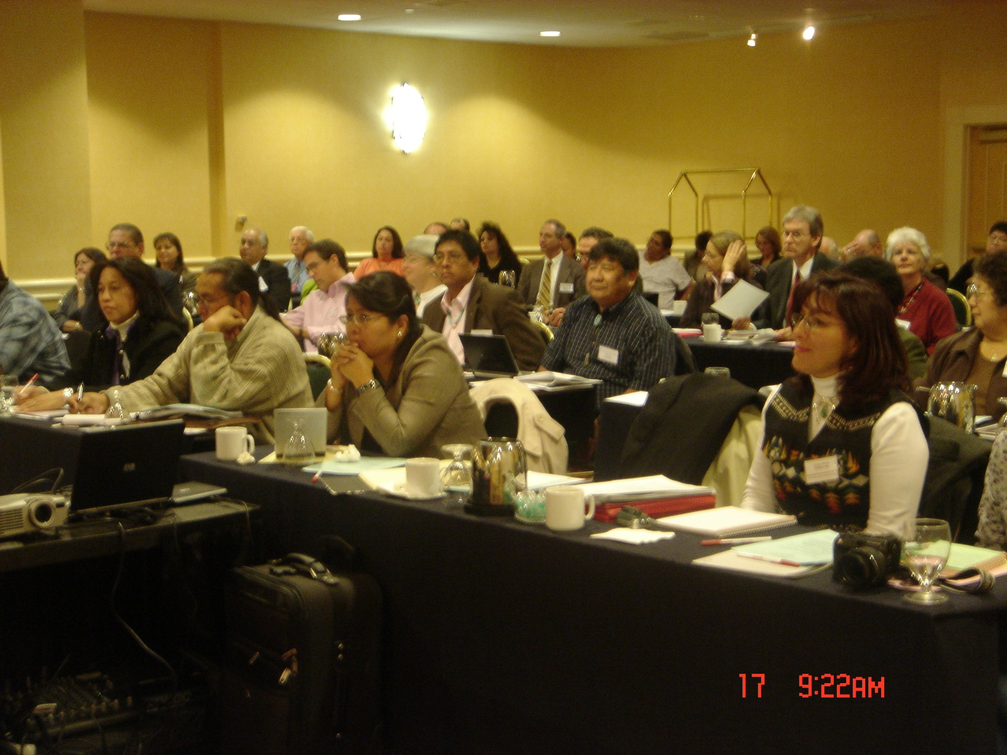
Summary List to Next Steps
Seek Navajo Nation Council approval of the Enabling Legislation for the NDoH.
Develop/Implement the five year Transition Plan.
Prepare for Public Health Accreditation readiness.
Update the Navajo Community Health Status Assessment
Address the beta test site cited deficiency areas.

Slide 42
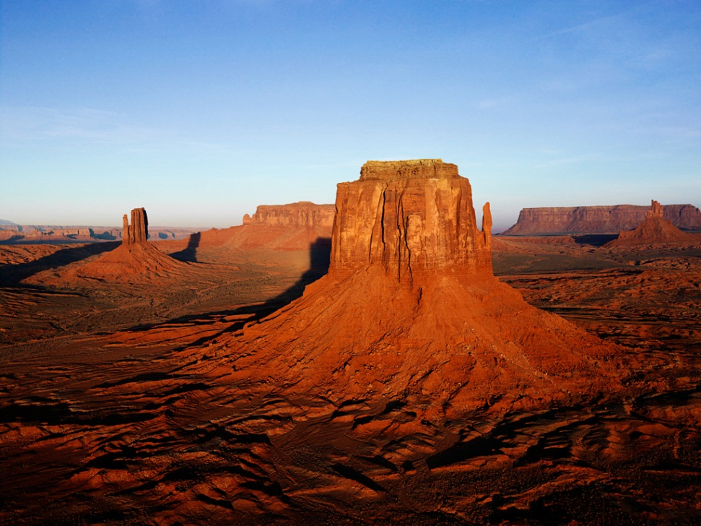
Closing Summary
The Navajo Nation hopes and plans to transform NDOH to a state like NDoPH to protect the health of all Navajos and continue to provide essential public health services. We look forward to our process in improving the health status of the Navajo. Thank you.

